Slide 1
Fast and Accurate Variational Inference for Models with Many Latent Variables
Ruben Loaiza-Maya, Michael Stanley Smith*, David J. Nott and Peter J. Danaher
J. of Econometrics (in press)
*Melbourne Business School
University of Melbourne (mikes70au@gmail.com)
ISBA June 2022

Slide 2
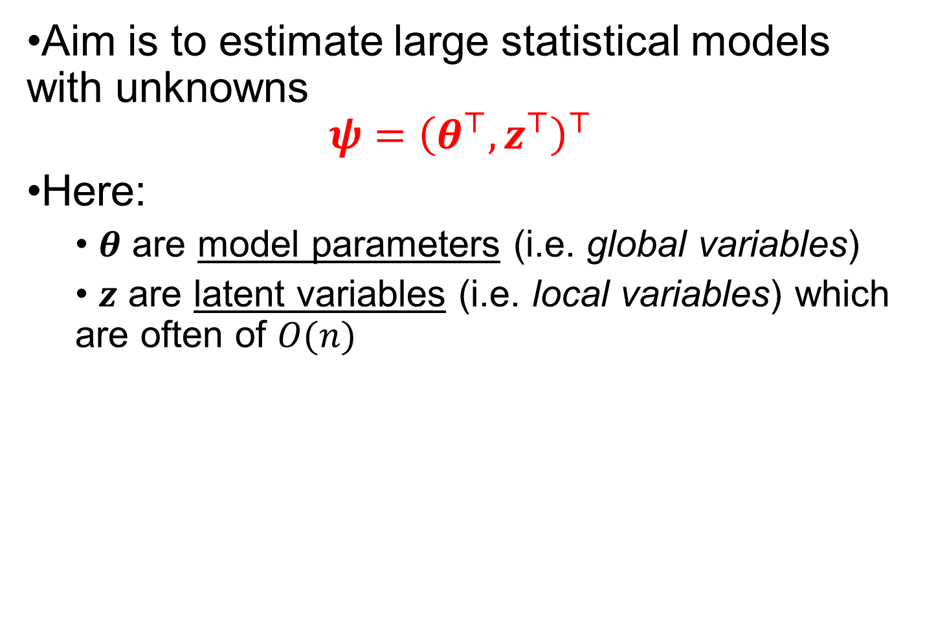
Introduction
Aim is to estimate large statistical models with unknowns
$$ψ={\left(θ^{⊤},z^{⊤}\right)}^{⊤}$$
Here:
$θ$ are model parameters (i.e. global variables)
$z$ are latent variables (i.e. local variables) which are often of $O(n)$

Slide 3
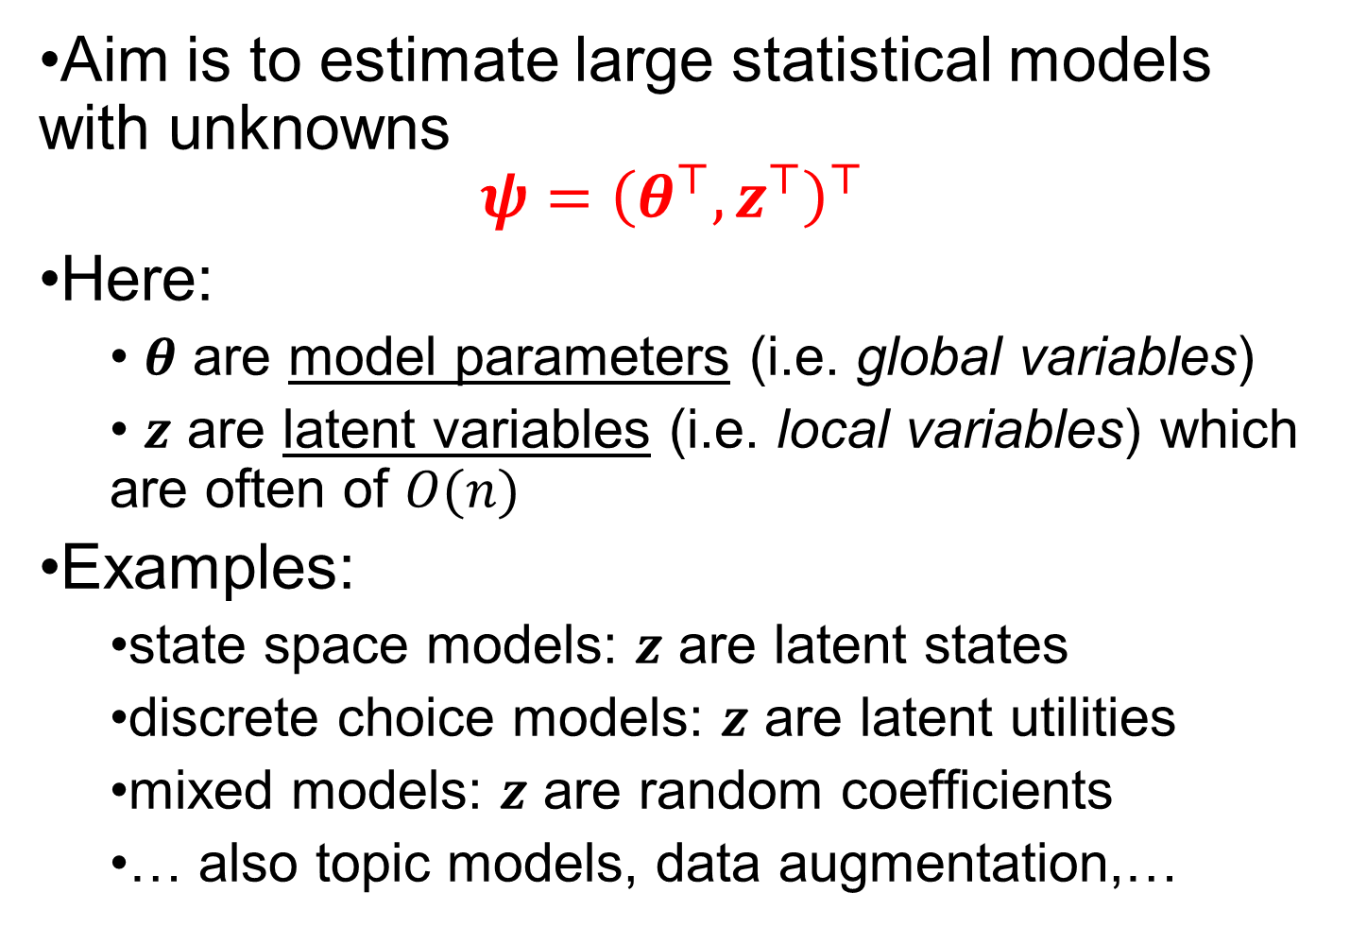
Introduction
Aim is to estimate large statistical models with unknowns
$$ψ={\left(θ^{⊤},z^{⊤}\right)}^{⊤}$$
Here:
$θ$ are model parameters (i.e. global variables)
$z$ are latent variables (i.e. local variables) which are often of $O(n)$
Examples:
state space models: $z$ are latent states
discrete choice models: $z$ are latent utilities
mixed models: $z$ are random coefficients
… also topic models, data augmentation,…

Slide 4
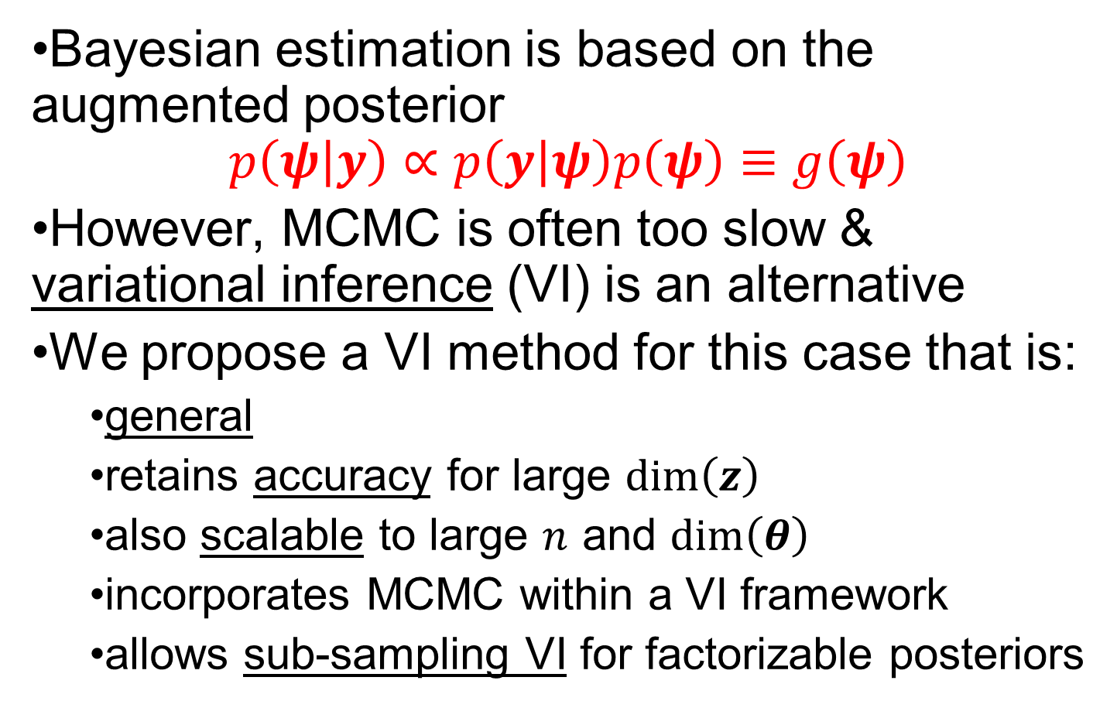
Introduction
Bayesian estimation is based on the augmented posterior
$$p\left(ψ | y\right)∝p\left(y | ψ\right)p\left(ψ\right)≡g\left(ψ\right)$$
However, MCMC is often too slow & variational inference (VI) is an alternative
We propose a VI method for this case that is:
general
retains accuracy for large $\dim\left(z\right)$
also scalable to large $n$ and $\dim\left(θ\right)$
incorporates MCMC within a VI framework
allows sub-sampling VI for factorizable posteriors

Slide 5
Introduction
Apply the method to estimate two complex econometric models:
Model 1: Large time-varying parameter VAR with stochastic volatility (TVP-VAR-SV)
Model 2: Random coefficient tobit model
capturing heterogeneity central
large marketing application
suitable for sub-sampling VI

Slide 6
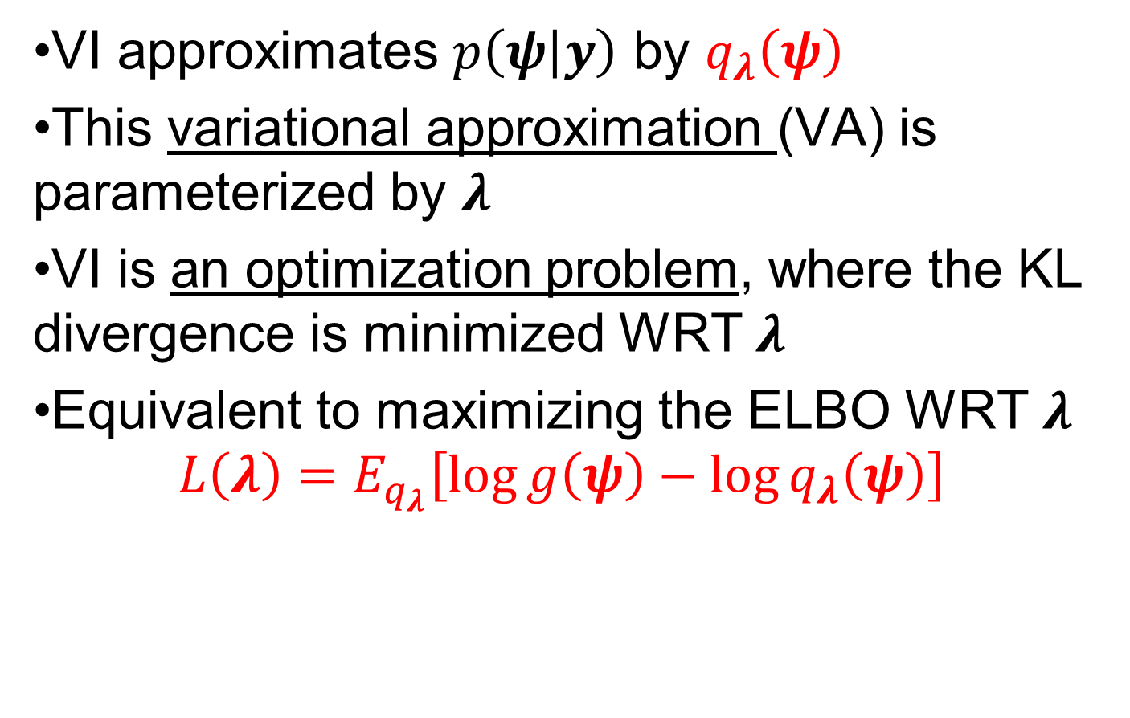
VI: An Approximate Method
VI approximates $p\left(ψ | y\right)$ by $q_{λ}\left(ψ\right)$
This variational approximation (VA) is parameterized by $λ$
VI is an optimization problem, where the KL divergence is minimized WRT $λ$
Equivalent to maximizing the ELBO WRT $λ$
$$L\left(λ\right)=E_{q_{λ}}\left[\log{g\left(ψ\right)−\log{q_{λ}\left(ψ\right)}}\right]$$

Slide 7
VI: An Approximate Method
VI approximates $p\left(ψ | y\right)$ by $q_{λ}\left(ψ\right)$
This variational approximation (VA) is parameterized by $λ$
VI is an optimization problem, where the KL divergence is minimized WRT $λ$
Equivalent to maximizing the ELBO WRT $λ$
$$L\left(λ\right)=E_{q_{λ}}\left[\log{g\left(ψ\right)−\log{q_{λ}\left(ψ\right)}}\right]$$
the posterior up to proportionality

Slide 8
VI: An Approximate Method
VI approximates $p\left(ψ | y\right)$ by $q_{λ}\left(ψ\right)$
This variational approximation (VA) is parameterized by $λ$
VI is an optimization problem, where the KL divergence is minimized WRT $λ$
Equivalent to maximizing the ELBO WRT $λ$
$$L\left(λ\right)=E_{q_{λ}}\left[\log{g\left(ψ\right)−\log{q_{λ}\left(ψ\right)}}\right]$$
the VA is chosen to be tractable

Slide 9
VI: An Approximate Method
VI approximates $p\left(ψ | y\right)$ by $q_{λ}\left(ψ\right)$
This variational approximation (VA) is parameterized by $λ$
VI is an optimization problem, where the KL divergence is minimized WRT $λ$
Equivalent to maximizing the ELBO WRT $λ$
$$L\left(λ\right)=E_{q_{λ}}\left[\log{g\left(ψ\right)−\log{q_{λ}\left(ψ\right)}}\right]$$
the expectation is WRT the VA

Slide 10

VI: Optimization Problem
Stochastic gradient ascent (SGA) is widely used to solve the optimization problem
Given initial guess $λ^{(0)}$, update recursively
$$λ^{(i+1)}=λ^{(i)}+ρ_{i}∘\hat{∇_{λ}L\left(λ^{\left(i\right)}\right)}$$

Slide 11
VI: Optimization Problem
Stochastic gradient ascent (SGA) is widely used to solve the optimization problem
Given initial guess $λ^{(0)}$, update recursively
$$λ^{(i+1)}=λ^{(i)}+ρ_{i}∘\hat{∇_{λ}L\left(λ^{\left(i\right)}\right)}$$
vector of adaptive step sizes (e.g. from ADADELTA)

Slide 12
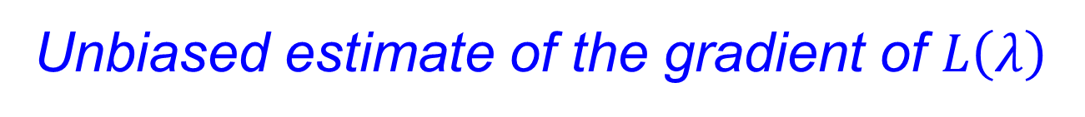
VI: Optimization Problem
Stochastic gradient ascent (SGA) is widely used to solve the optimization problem
Given initial guess $λ^{(0)}$, update recursively
$$λ^{(i+1)}=λ^{(i)}+ρ_{i}∘\hat{∇_{λ}L\left(λ^{\left(i\right)}\right)}$$
Unbiased estimate of the gradient of $L\left(λ\right)$

Slide 13
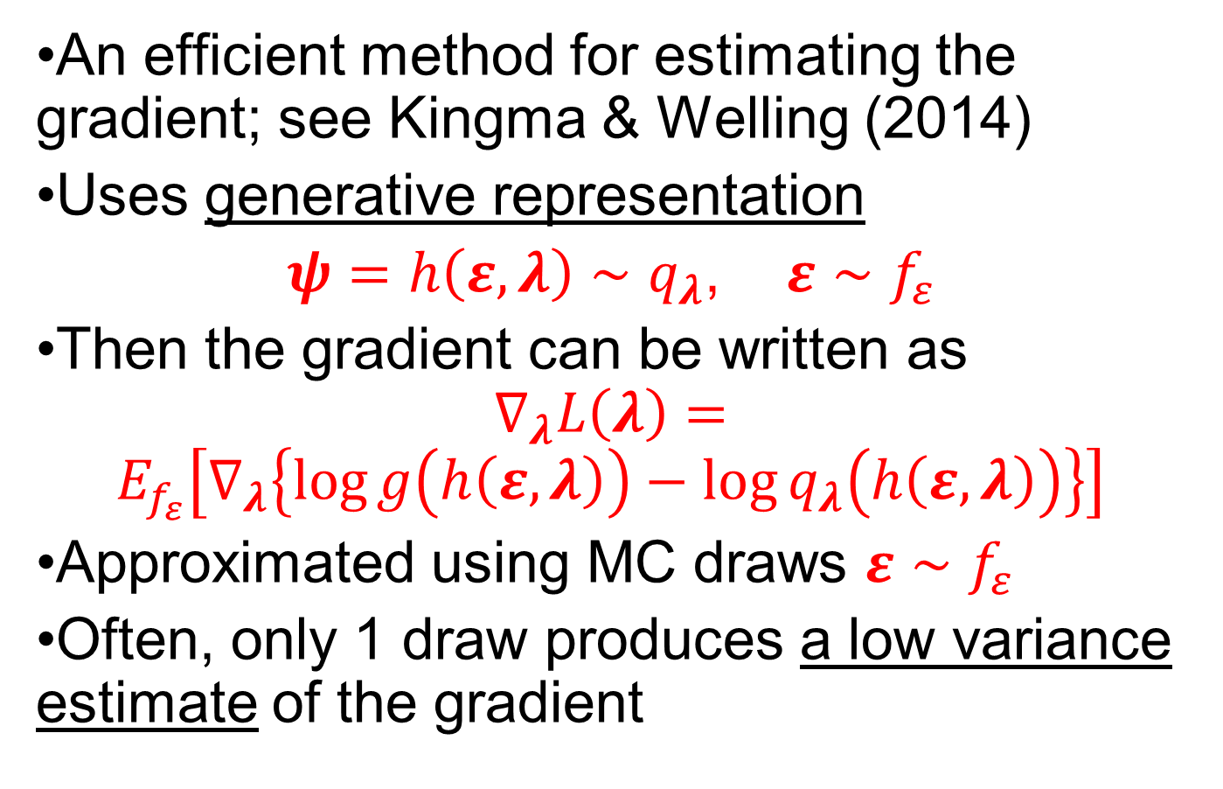
VI: Re-parameterization Trick
An efficient method for estimating the gradient; see Kingma & Welling (2014)
Uses generative representation
$ψ=h\left(ε,λ\right)∼q_{λ}$, $ε∼f_{ε}$
Then the gradient can be written as
$$∇_{λ}L\left(λ\right)=$$
$$E_{f_{ε}}\left[∇_{λ}\left\{\log{g\left(h\left(ε,λ\right)\right)−\log{q_{λ}\left(h\left(ε,λ\right)\right)}}\right\}\right]$$
Approximated using MC draws $ε∼f_{ε}$
Often, only 1 draw produces a low variance estimate of the gradient

Slide 14

VA for models with latent variables
We use the VA
$$q_{λ}\left(θ,z\right)=p\left(z | θ,y\right)q_{λ}^{0}\left(θ\right)$$

Slide 15

VA for models with latent variables
We use the VA
$$q_{λ}\left(θ,z\right)=p\left(z | θ,y\right)q_{λ}^{0}\left(θ\right)$$
Uses the exact conditional posterior of $z$

Slide 16
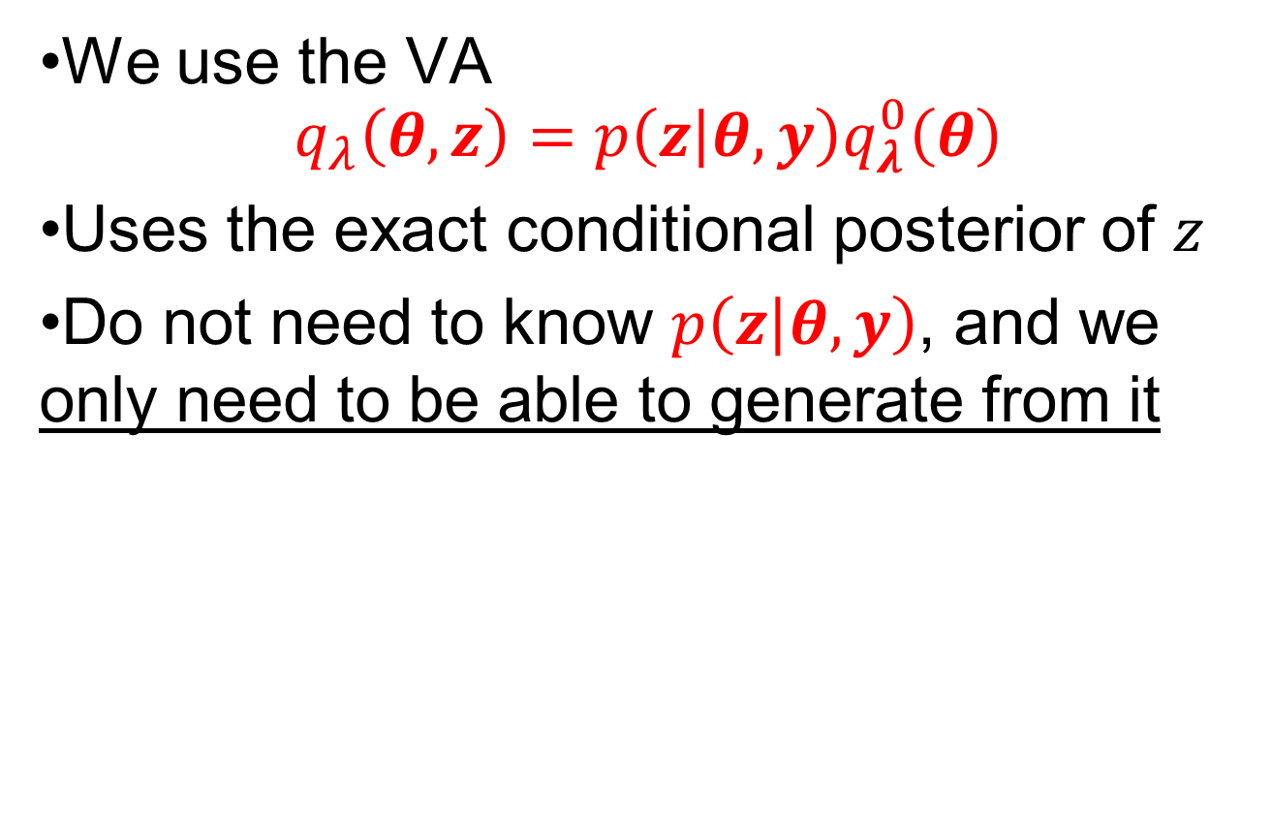
VA for models with latent variables
We use the VA
$$q_{λ}\left(θ,z\right)=p\left(z | θ,y\right)q_{λ}^{0}\left(θ\right)$$
Uses the exact conditional posterior of $z$
Do not need to know $p\left(z | θ,y\right)$, and we only need to be able to generate from it

Slide 17
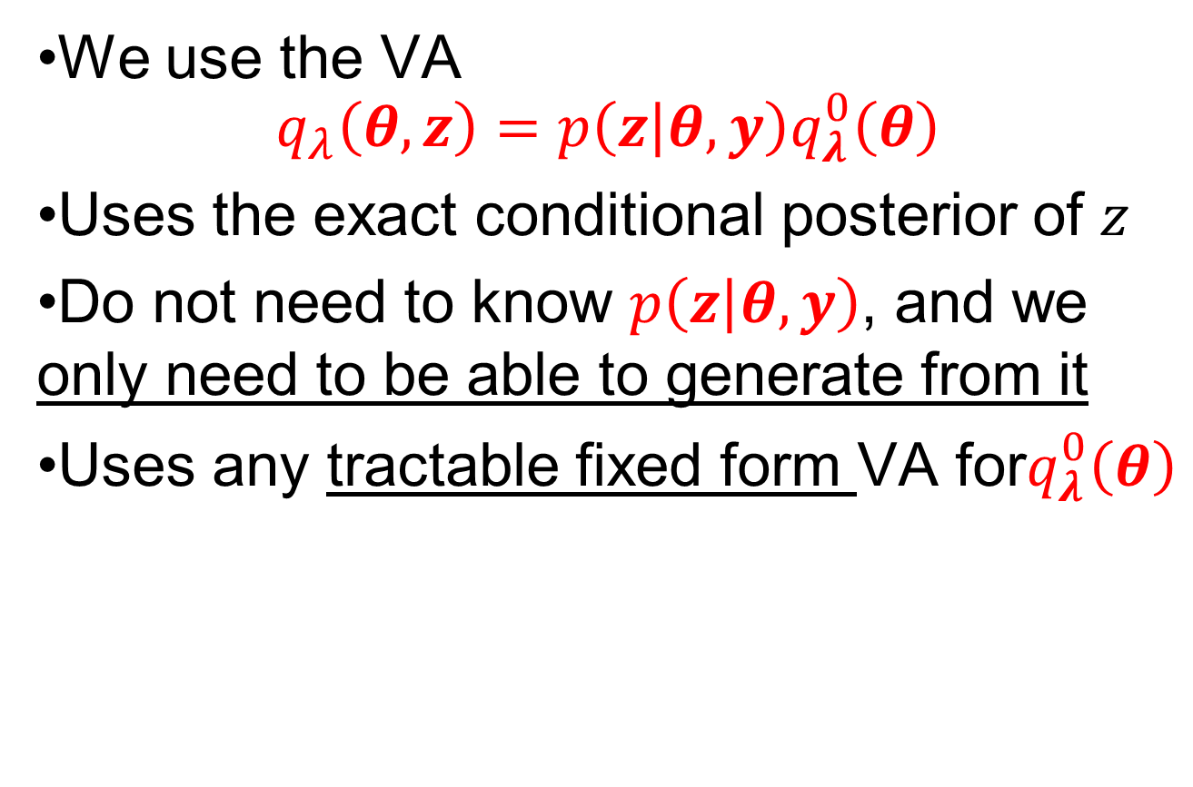
VA for models with latent variables
We use the VA
$$q_{λ}\left(θ,z\right)=p\left(z | θ,y\right)q_{λ}^{0}\left(θ\right)$$
Uses the exact conditional posterior of $z$
Do not need to know $p\left(z | θ,y\right)$, and we only need to be able to generate from it
Uses any tractable fixed form VA for$q_{λ}^{0}\left(θ\right)$

Slide 18
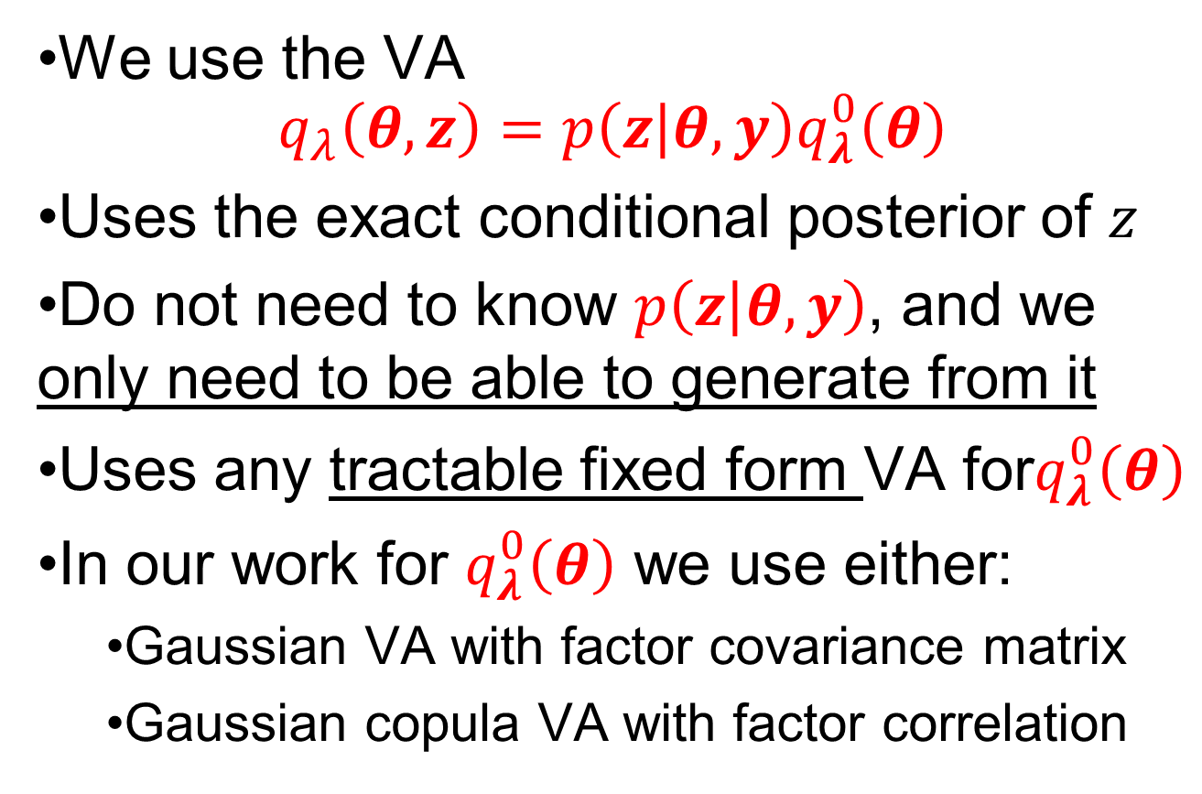
VA for models with latent variables
We use the VA
$$q_{λ}\left(θ,z\right)=p\left(z | θ,y\right)q_{λ}^{0}\left(θ\right)$$
Uses the exact conditional posterior of $z$
Do not need to know $p\left(z | θ,y\right)$, and we only need to be able to generate from it
Uses any tractable fixed form VA for$q_{λ}^{0}\left(θ\right)$
In our work for $q_{λ}^{0}\left(θ\right)$ we use either:
Gaussian VA with factor covariance matrix
Gaussian copula VA with factor correlation

Slide 19
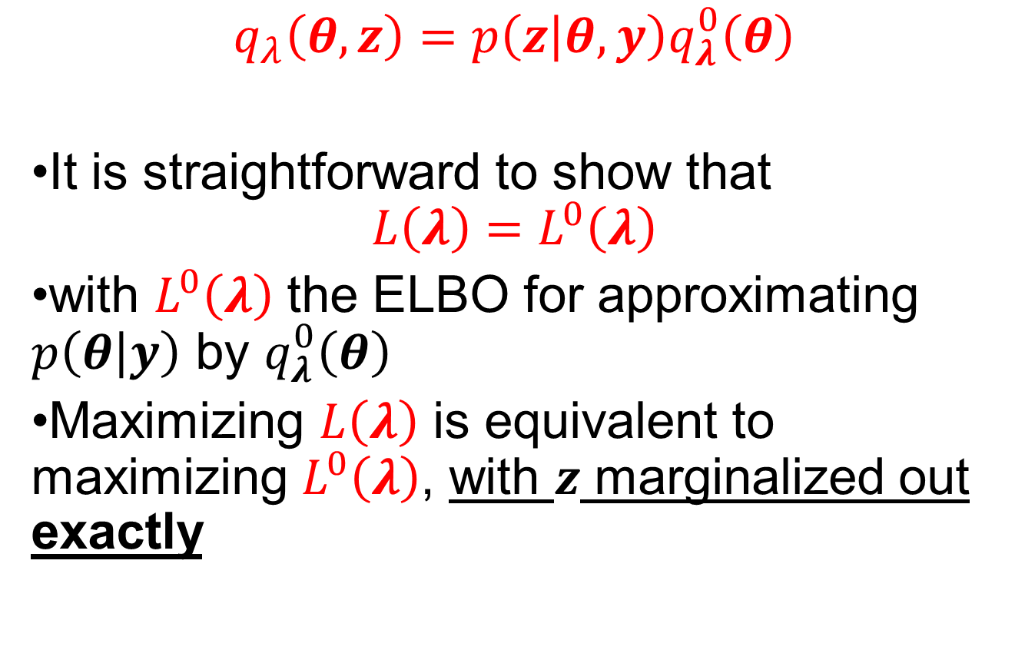
Approximation Advantage 1
$$q_{λ}\left(θ,z\right)=p\left(z | θ,y\right)q_{λ}^{0}\left(θ\right)$$
It is straightforward to show that
$$L\left(λ\right)=L^{0}\left(λ\right)$$
with $L^{0}\left(λ\right)$ the ELBO for approximating $p\left(θ | y\right)$ by $q_{λ}^{0}\left(θ\right)$
Maximizing $L\left(λ\right)$ is equivalent to maximizing $L^{0}\left(λ\right)$, with $z$ marginalized out exactly

Slide 20
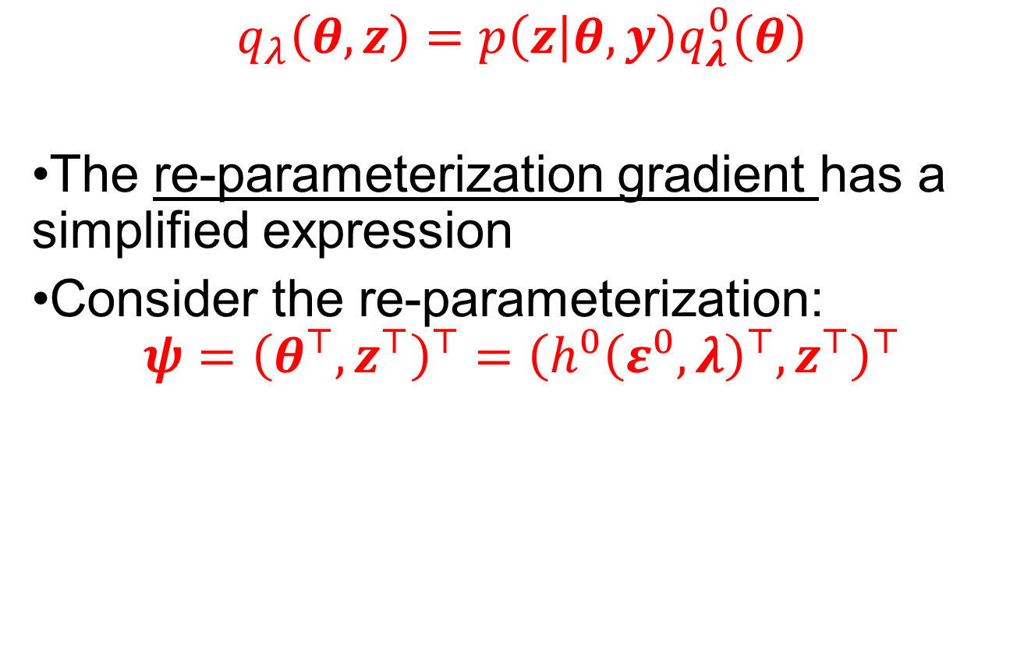
Approximation Advantage 2
$$q_{λ}\left(θ,z\right)=p\left(z | θ,y\right)q_{λ}^{0}\left(θ\right)$$
The re-parameterization gradient has a simplified expression
Consider the re-parameterization:
$$ψ={\left(θ^{⊤},z^{⊤}\right)}^{⊤}={\left(h^{0}{\left(ε^{0},λ\right)}^{⊤},z^{⊤}\right)}^{⊤}$$

Slide 21
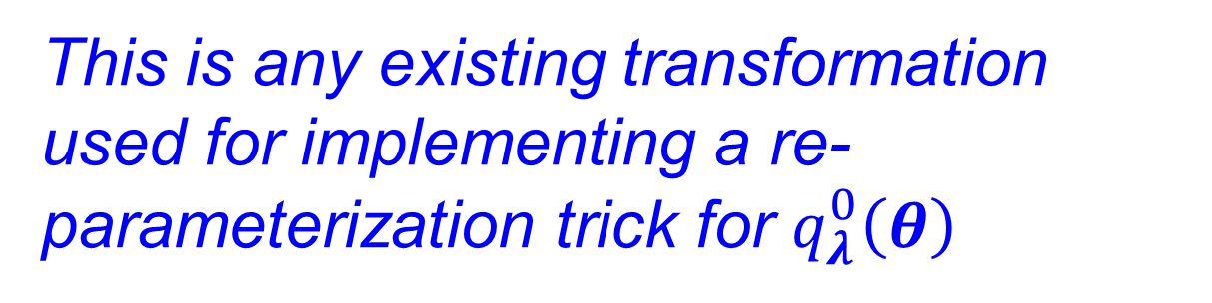
Approximation Advantage 2
$$q_{λ}\left(θ,z\right)=p\left(z | θ,y\right)q_{λ}^{0}\left(θ\right)$$
The re-parameterization gradient has a simplified expression
Consider the re-parameterization:
$$ψ={\left(θ^{⊤},z^{⊤}\right)}^{⊤}={\left(h^{0}{\left(ε^{0},λ\right)}^{⊤},z^{⊤}\right)}^{⊤}$$
This is any existing transformation used for implementing a re-parameterization trick for $q_{λ}^{0}\left(θ\right)$

Slide 22
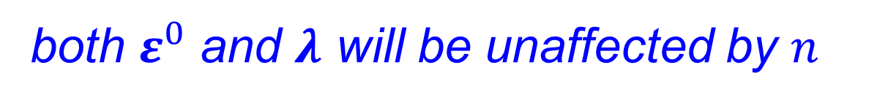
Approximation Advantage 2
$$q_{λ}\left(θ,z\right)=p\left(z | θ,y\right)q_{λ}^{0}\left(θ\right)$$
The re-parameterization gradient has a simplified expression
Consider the re-parameterization:
$$ψ={\left(θ^{⊤},z^{⊤}\right)}^{⊤}={\left(h^{0}{\left(ε^{0},λ\right)}^{⊤},z^{⊤}\right)}^{⊤}$$
both $ε^{0}$ and $λ$ will be unaffected by $n$

Slide 23
Approximation Advantage 2
$$q_{λ}\left(θ,z\right)=p\left(z | θ,y\right)q_{λ}^{0}\left(θ\right)$$
The re-parameterization gradient has a simplified expression
Consider the re-parameterization:
$$ψ={\left(θ^{⊤},z^{⊤}\right)}^{⊤}={\left(h^{0}{\left(ε^{0},λ\right)}^{⊤},z^{⊤}\right)}^{⊤}$$
this is just the identity transformation

Slide 24
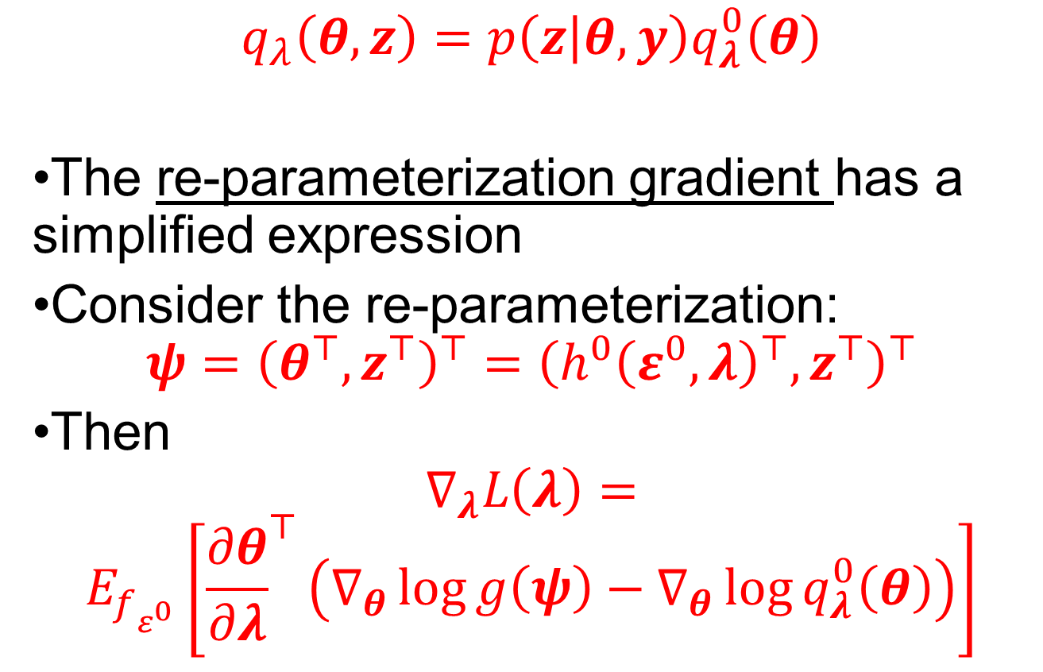
Approximation Advantage 2
$$q_{λ}\left(θ,z\right)=p\left(z | θ,y\right)q_{λ}^{0}\left(θ\right)$$
The re-parameterization gradient has a simplified expression
Consider the re-parameterization:
$$ψ={\left(θ^{⊤},z^{⊤}\right)}^{⊤}={\left(h^{0}{\left(ε^{0},λ\right)}^{⊤},z^{⊤}\right)}^{⊤}$$
Then
$$∇_{λ}L\left(λ\right)=$$
$$E_{f_{ε^{0}}}\left[{\frac{∂θ}{∂λ}}^{⊤}\left(∇_{θ}\log{g\left(ψ\right)}−∇_{θ}\log{q_{λ}^{0}\left(θ\right)}\right)\right]$$

Slide 25
VI Algorithm with SGA

Slide 26
VI Algorithm with SGA
Generate exactly for some models, use MCMC for other models

Slide 27
VI Algorithm with SGA

Slide 28
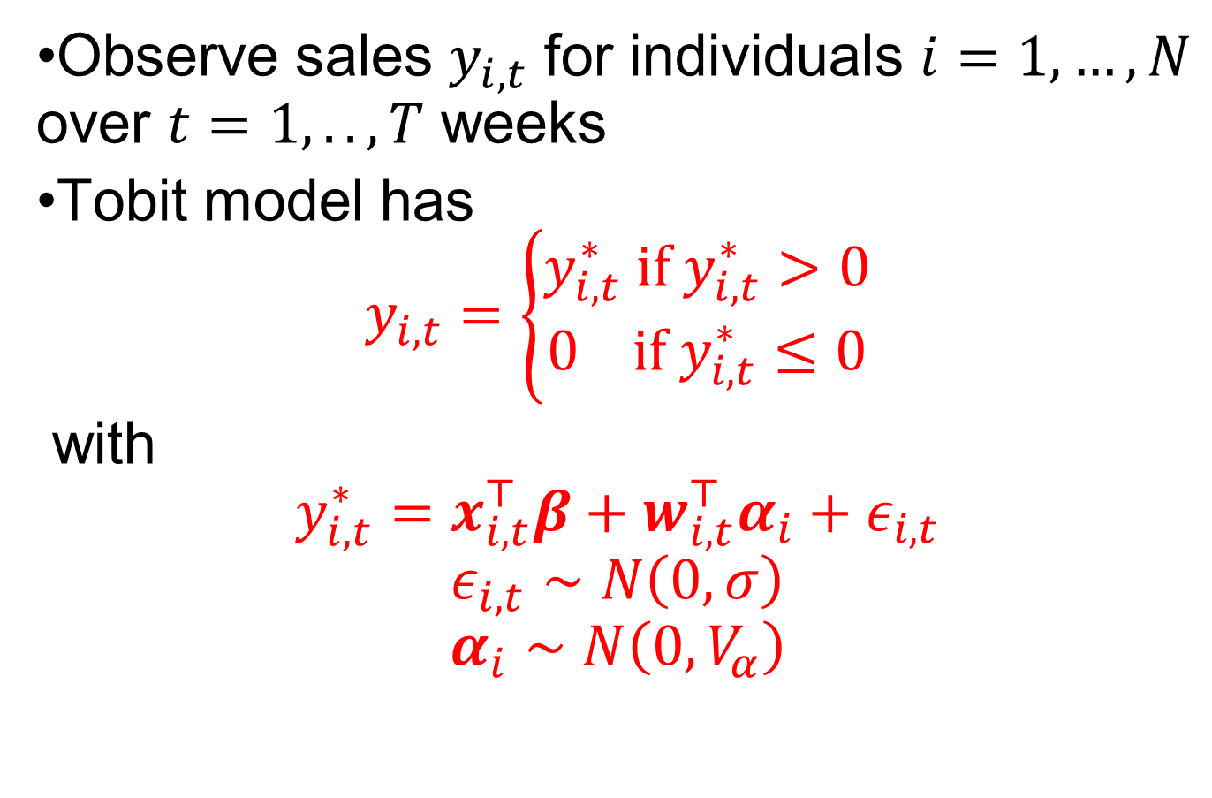
Random Coefficient Tobit Model
Observe sales $y_{i,t}$ for individuals $i=1,…,N$ over $t=1,..,T$ weeks
Tobit model has
$$y_{i,t}=\left\{\begin{matrix}y_{i,t}^{∗} if y_{i,t}^{∗}>0 \\ 0 if y_{i,t}^{∗}≤0\end{matrix}\right.$$
with
$$y_{i,t}^{∗}=x_{i,t}^{⊤}β+w_{i,t}^{⊤}α_{i}+ε_{i,t}$$
$$ε_{i,t}∼N\left(0,σ\right)$$
$$α_{i}∼N\left(0,V_{α}\right)$$

Slide 29
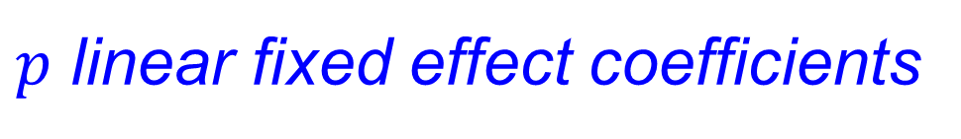
Random Coefficient Tobit Model
Observe sales $y_{i,t}$ for individuals $i=1,…,N$ over $t=1,..,T$ weeks
Tobit model has
$$y_{i,t}=\left\{\begin{matrix}y_{i,t}^{∗} if y_{i,t}^{∗}>0 \\ 0 if y_{i,t}^{∗}≤0\end{matrix}\right.$$
with
$$y_{i,t}^{∗}=x_{i,t}^{⊤}β+w_{i,t}^{⊤}α_{i}+ε_{i,t}$$
$$ε_{i,t}∼N\left(0,σ\right)$$
$$α_{i}∼N\left(0,V_{α}\right)$$
$p$ linear fixed effect coefficients

Slide 30
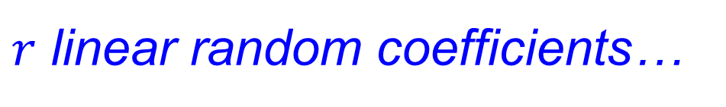
Random Coefficient Tobit Model
Observe sales $y_{i,t}$ for individuals $i=1,…,N$ over $t=1,..,T$ weeks
Tobit model has
$$y_{i,t}=\left\{\begin{matrix}y_{i,t}^{∗} if y_{i,t}^{∗}>0 \\ 0 if y_{i,t}^{∗}≤0\end{matrix}\right.$$
with
$$y_{i,t}^{∗}=x_{i,t}^{⊤}β+w_{i,t}^{⊤}α_{i}+ε_{i,t}$$
$$ε_{i,t}∼N\left(0,σ\right)$$
$$α_{i}∼N\left(0,V_{α}\right)$$
$r$ linear random coefficients…

Slide 31
Random Coefficient Tobit Model
Observe sales $y_{i,t}$ for individuals $i=1,…,N$ over $t=1,..,T$ weeks
Tobit model has
$$y_{i,t}=\left\{\begin{matrix}y_{i,t}^{∗} if y_{i,t}^{∗}>0 \\ 0 if y_{i,t}^{∗}≤0\end{matrix}\right.$$
with
$$y_{i,t}^{∗}=x_{i,t}^{⊤}β+w_{i,t}^{⊤}α_{i}+ε_{i,t}$$
$$ε_{i,t}∼N\left(0,σ\right)$$
$$α_{i}∼N\left(0,V_{α}\right)$$
…with multivariate Gaussian distribution

Slide 32
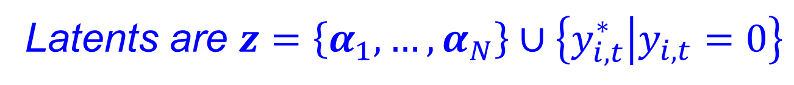
Random Coefficient Tobit Model
Observe sales $y_{i,t}$ for individuals $i=1,…,N$ over $t=1,..,T$ weeks
Tobit model has
$$y_{i,t}=\left\{\begin{matrix}y_{i,t}^{∗} if y_{i,t}^{∗}>0 \\ 0 if y_{i,t}^{∗}≤0\end{matrix}\right.$$
with
$$y_{i,t}^{∗}=x_{i,t}^{⊤}β+w_{i,t}^{⊤}α_{i}+ε_{i,t}$$
$$ε_{i,t}∼N\left(0,σ\right)$$
$$α_{i}∼N\left(0,V_{α}\right)$$
Latents are $z=\left\{α_{1},…,α_{N}\right\}∪\left\{y_{i,t}^{∗} | y_{i,t}=0\right\}$

Slide 33
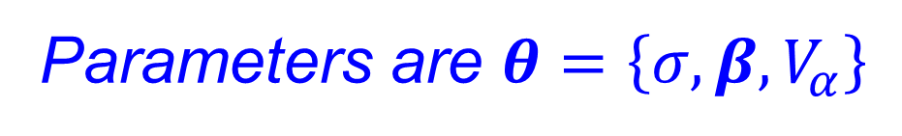
Random Coefficient Tobit Model
Observe sales $y_{i,t}$ for individuals $i=1,…,N$ over $t=1,..,T$ weeks
Tobit model has
$$y_{i,t}=\left\{\begin{matrix}y_{i,t}^{∗} if y_{i,t}^{∗}>0 \\ 0 if y_{i,t}^{∗}≤0\end{matrix}\right.$$
with
$$y_{i,t}^{∗}=x_{i,t}^{⊤}β+w_{i,t}^{⊤}α_{i}+ε_{i,t}$$
$$ε_{i,t}∼N\left(0,σ\right)$$
$$α_{i}∼N\left(0,V_{α}\right)$$
Parameters are $θ=\left\{σ,β,V_{α}\right\}$

Slide 34

Small Data Example
Use marketing database discussed in Danaher et al. (JMR, 2020)
Employ small sample for which $p\left(θ | y\right)$ can be computed using MCMC (27hr)
$N=1000, T=100, p=32, r=4$

Slide 35
Small Data Example

Slide 36
Small Data Example

Slide 37
Small Data Example

Slide 38

Large Data Example
Not possible to use MCMC in reasonable time
$N=20,000, T=100, p=32, r=10$
Compared against other VAs and RMSE as a metric of “fit”

Slide 39
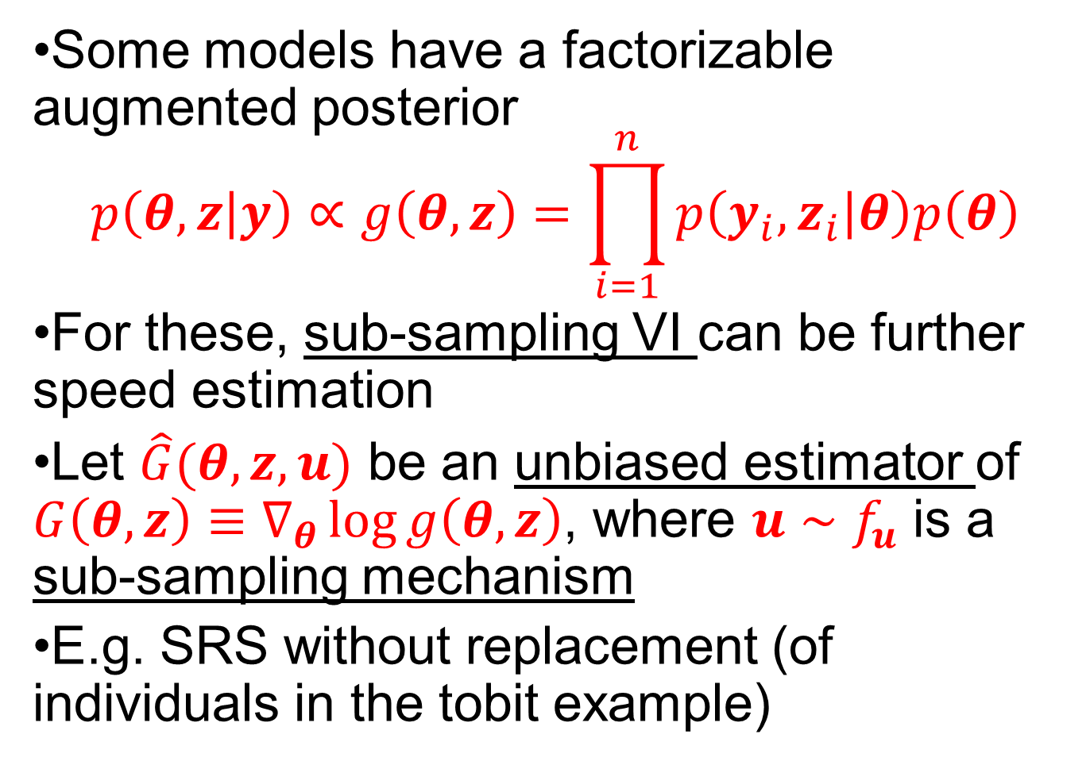
Sub-Sampling VI
Some models have a factorizable augmented posterior
$$p\left(θ,z | y\right)∝g\left(θ,z\right)=\prod_{i=1}^{n}{p\left(y_{i},z_{i} | θ\right)p\left(θ\right)}$$
For these, sub-sampling VI can be further speed estimation
Let $\hat{G}(θ,z,u)$ be an unbiased estimator of $G\left(θ, z\right)≡∇_{θ}\log{g\left(θ, z\right)}$, where $u∼f_{u}$ is a sub-sampling mechanism
E.g. SRS without replacement (of individuals in the tobit example)

Slide 40

Sub-Sampling VI
Then the re-parameterization gradient can be written as
$$∇_{λ}L\left(λ\right)=$$
$$E_{f_{ε^{0}}f_{u}}\left[{\frac{∂θ}{∂λ}}^{⊤}\left(\hat{G}(θ,z,u)−∇_{θ}\log{q_{λ}^{0}\left(θ\right)}\right)\right]$$

Slide 41
Sub-Sampling VI
Then the re-parameterization gradient can be written as
$$∇_{λ}L\left(λ\right)=$$
$$E_{f_{ε^{0}}f_{u}}\left[{\frac{∂θ}{∂λ}}^{⊤}\left(\hat{G}(θ,z,u)−∇_{θ}\log{q_{λ}^{0}\left(θ\right)}\right)\right]$$
Simply replace the derivative of the log-posterior with its unbiased estimate…

Slide 42

Sub-Sampling VI
Then the re-parameterization gradient can be written as
$$∇_{λ}L\left(λ\right)=$$
$$E_{f_{ε^{0}}f_{u}}\left[{\frac{∂θ}{∂λ}}^{⊤}\left(\hat{G}(θ,z,u)−∇_{θ}\log{q_{λ}^{0}\left(θ\right)}\right)\right]$$
..and then take the expectation over the sub-sampling mechanism $f_{u}$

Slide 43
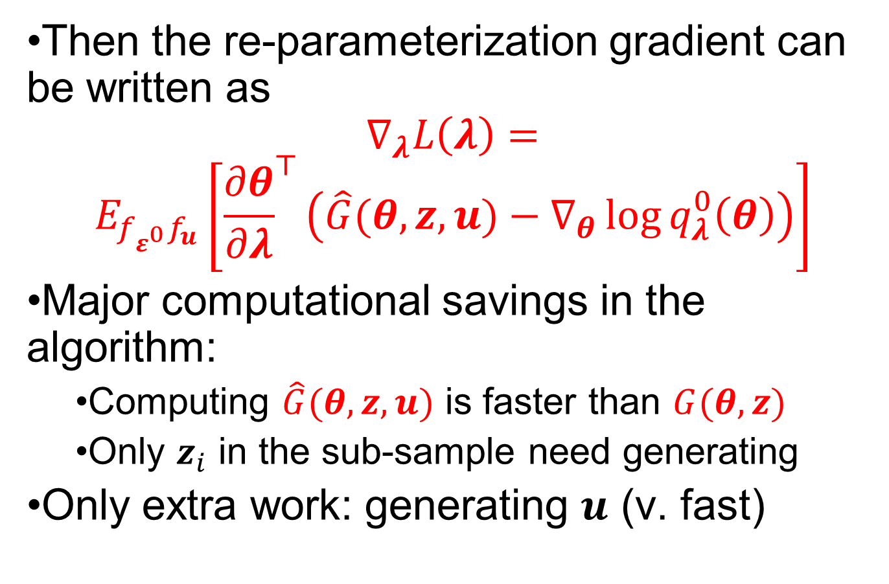
Sub-Sampling VI
Then the re-parameterization gradient can be written as
$$∇_{λ}L\left(λ\right)=$$
$$E_{f_{ε^{0}}f_{u}}\left[{\frac{∂θ}{∂λ}}^{⊤}\left(\hat{G}(θ,z,u)−∇_{θ}\log{q_{λ}^{0}\left(θ\right)}\right)\right]$$
Major computational savings in the algorithm:
Computing $\hat{G}(θ,z,u)$ is faster than $G(θ,z)$
Only $z_{i}$ in the sub-sample need generating
Only extra work: generating $u$ (v. fast)

Slide 44
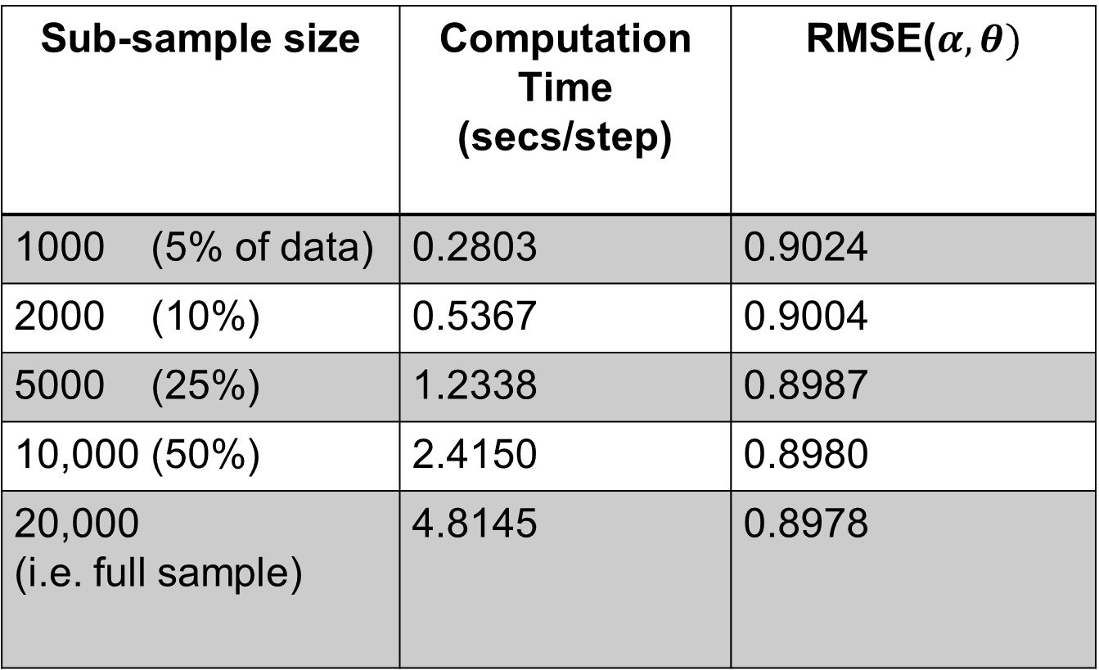
Tobit Example: Speedup
Sub-sample size | Computation Time (secs/step) | RMSE($α,θ)$
1000 (5% of data) | 0.2803 | 0.9024
2000 (10%) | 0.5367 | 0.9004
5000 (25%) | 1.2338 | 0.8987
10,000 (50%) | 2.4150 | 0.8980
20,000 (i.e. full sample) | 4.8145 | 0.8978

Slide 45
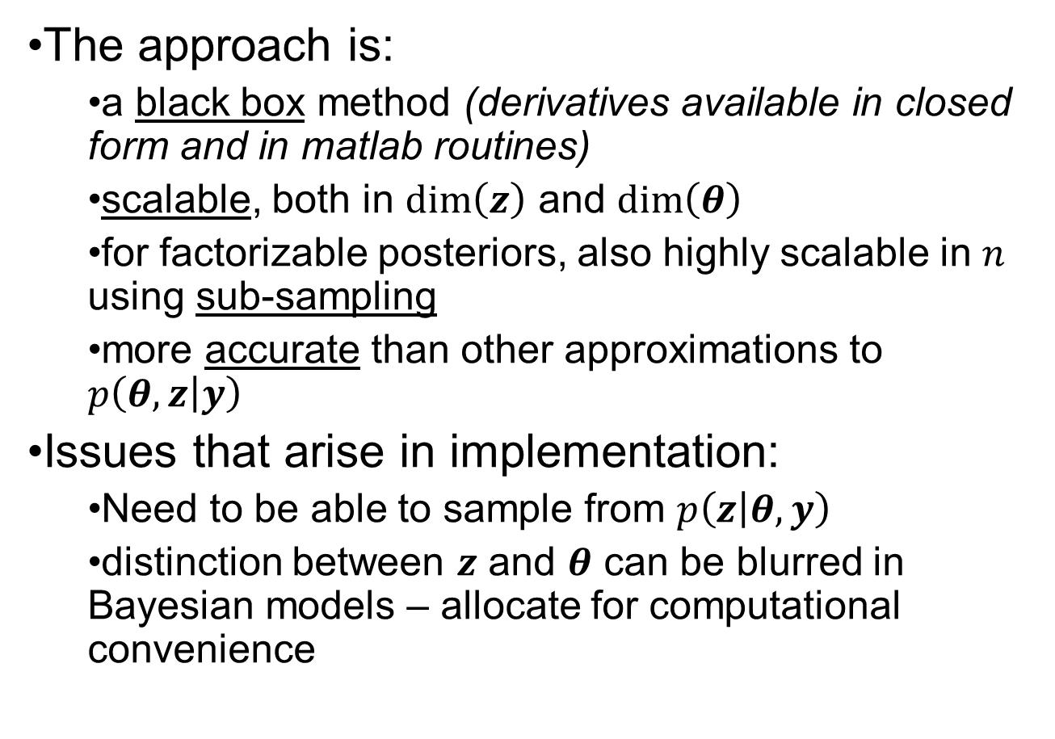
Discussion
The approach is:
a black box method (derivatives available in closed form and in matlab routines)
scalable, both in $\dim\left(z\right)$ and $\dim\left(θ\right)$
for factorizable posteriors, also highly scalable in $n$ using sub-sampling
more accurate than other approximations to $p\left(θ,z | y\right)$
Issues that arise in implementation:
Need to be able to sample from $p\left(z | θ,y\right)$
distinction between $z$ and $θ$ can be blurred in Bayesian models – allocate for computational convenience

